Slide 1
Project Presentation
Topic: Create Chess Pieces Using OpenGL Tools

Slide 2
Group members
Syed Nazmul Bin Nazrul ID: 141-15-3225
Mostofa Mahatab Sunny ID: 141-15-3232

Slide 3
INTRODUCTION
The aim of the project is to come up with the pieces of chess.
In our class, we were making single chess piece. Then we tried to make all chess pieces in this project.
The game of chess is the games where two players are involved one takes pieces that are white and another that are black.
It consisting of different snap shorts have been taken to future explain how class program works.
Firstly the programmer had started to look at the pieces of chess and the chess board, thereafter a chess board together with pieces.

Slide 4
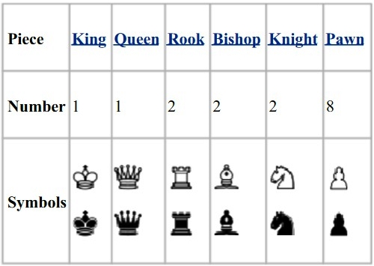

Slide 5
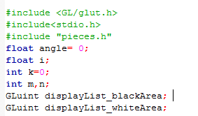
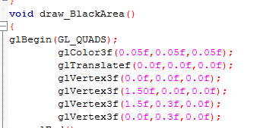
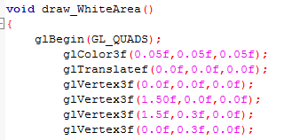
Main.c
GLuint displayList_blackArea;
GLuint displayList_whiteArea;
GL_QUADS
A quad is any shape with 4 vertices: a rectangle, a square, a trapezoid, etc. The position of the vertices will define what type of shape it is.

Slide 6
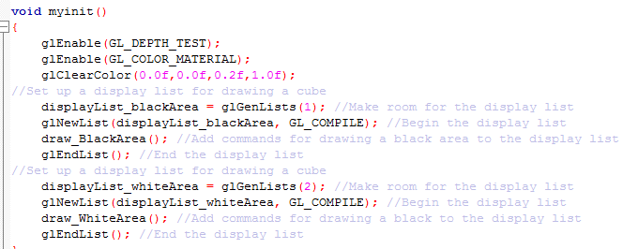
Main.c
Main work starts from calling myinit();
//myinit() function calls two fuctions draw_Blackarea() and draw_WhiteArea()
//These functions create white and black quads along with x,y,z axis sothat it is in 3d format

Slide 7
Main.c
Next calling PiecesInit();
//declared in pieces.c file //this function helps to create not displaying
//for 3d drawing you need some materials of color, light, shining, glow etc
//So in PiecesInit() at first some necessary materials are declared
//Then all chess pawns create by using Cylindrical shape and using Translate (set the position of quad where it wants to create) and Rotate for defining its angle
Next calling glutDisplayFunc(drawScene);
//this function starts to display all chess pawns with the help of matrxMode() by calling PawnDisplay() function (declared in Pieces.c file)
Next calling glutKeyboardFunc(Keypress);
//this function will work when you press key and terminates the program
Next calling glutReshapeFunc(myReshape);
//this function sets 3d camera view (perpective view)
Next calling glutMotionFunc(motion) and glutTimerFunc(25, update, 0);
//both functions are help to rotating (360 degree) display
//glutTimerFunc() function calls update function

Slide 8
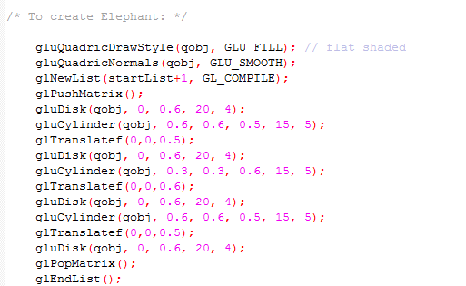
Pieces.c
GLU_FILL specifies translates by filled polygons, where the polygons are drawn in a counterclockwise fashion.

Slide 9
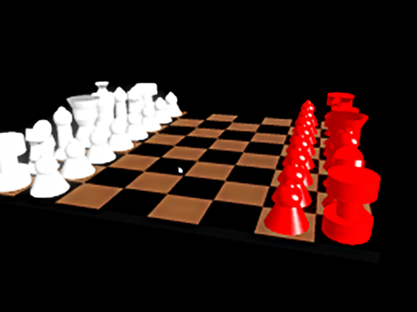
OUTPUT

Slide 10
THANK YOU

